Slide 1
Data Analysis of Cryptocurrency on the web Application

Slide 2
Group Members
Hardik (200521380)(Developer)
Worked in frontend and backend
Pinkeshkumar Patel (200497326) (Data Analyst)
Work on the database, visualization and on web app hosting.
Jay Shah (200520177) (Project Manager and Business analyst)
Worked as a project manager and built documentation.

Slide 3
Step 1 ( Acquire Data using python)
Used API to get data.
We have used Binance API to get data
Here is an API key :
"https://api.binance.com/api/v3/ticker/price?symbol=“

Slide 4
Basically, we have used a python program to acquire data which is shown in the next slide.
The database is Mongo DB which we have used to store the acquired data.
In that program, there is a mongo DB connection which we have provided to connect the database.
We get the data every 24 hours.

Slide 5
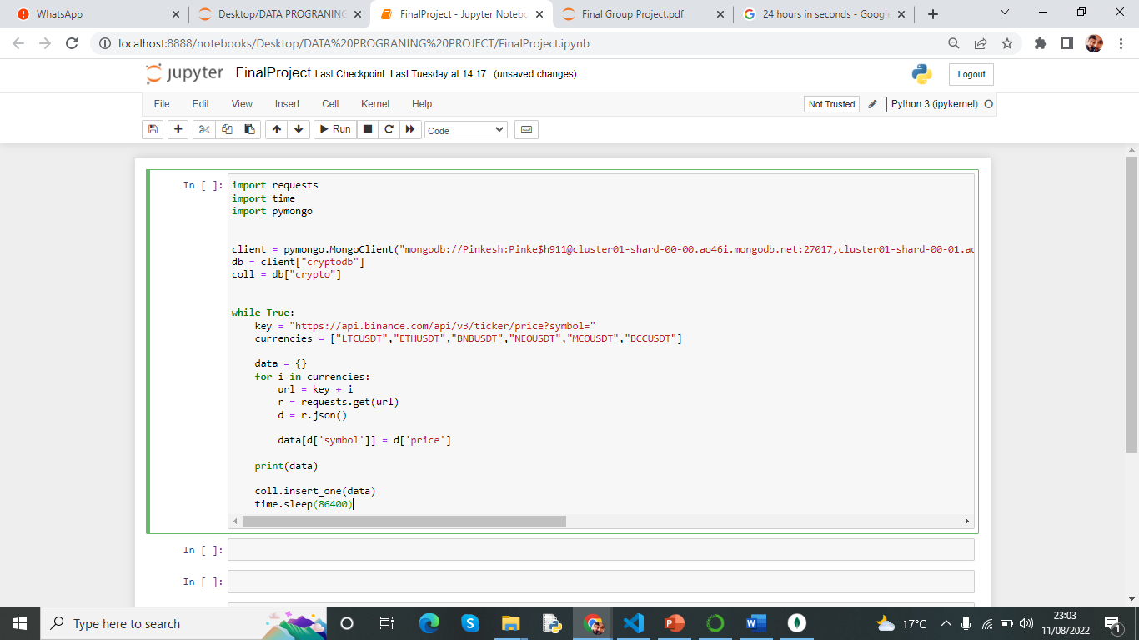
Python code which used to get data

Slide 6

Step 2 ( Store acquired data in a database )

Slide 7
Used cloud data storage.
We had to use a cloud platform to store data.
We have used Mongo DB to store Data.
First, we have created a mongo DB account.
Then, we have created a cluster in mongo DB, as seen in the next slide.
And we have created a Database called cryptodb where we store our data.

Slide 8
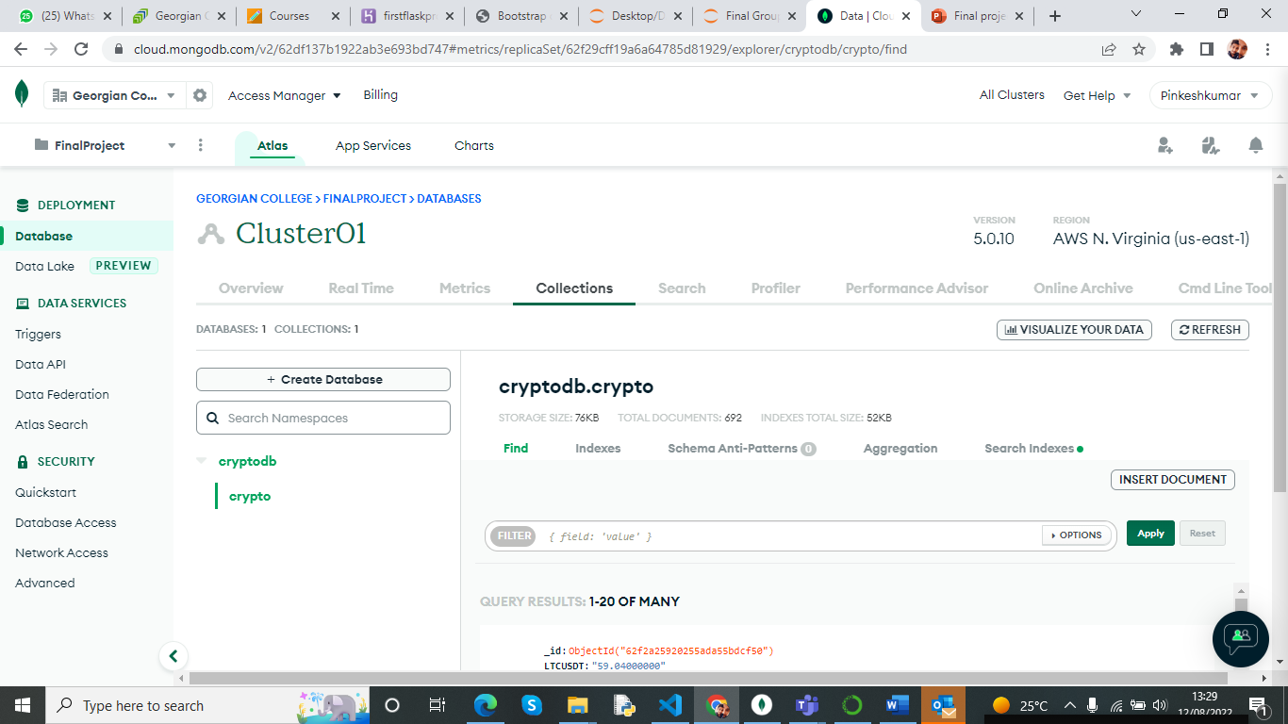
Mongo DB cluster which we have created.

Slide 9
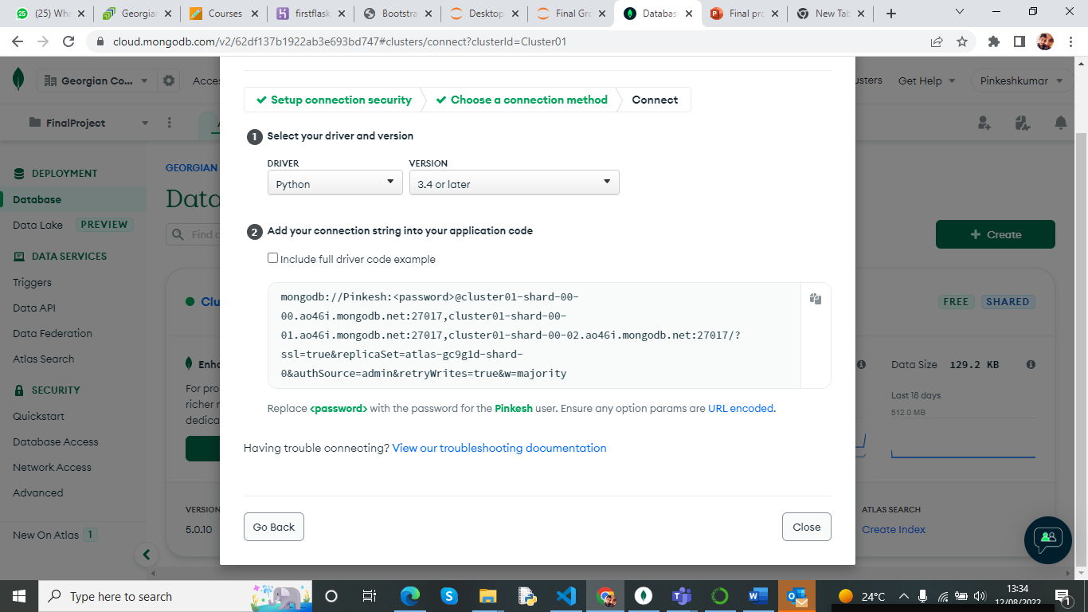
Use this link to connect our application to the database. And we have selected python verson3.4 or later

Slide 10
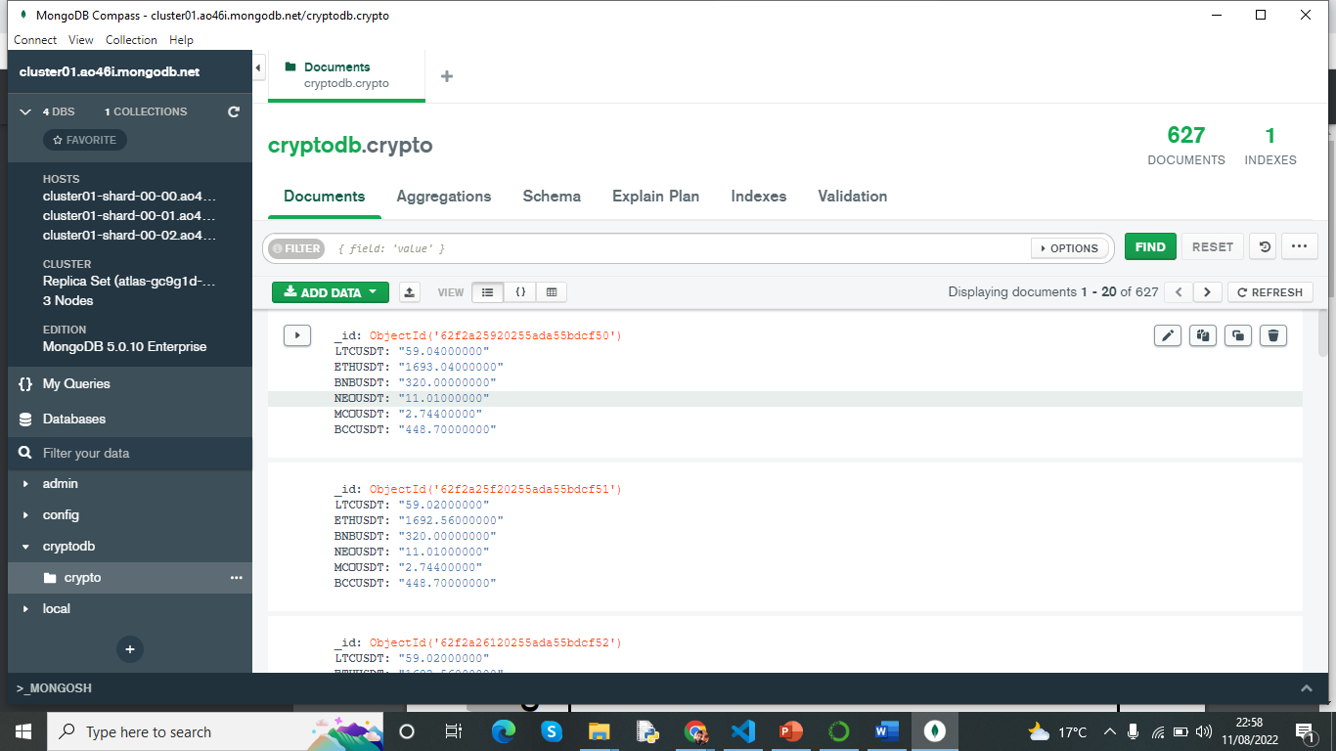
Used mongo DB compass to see the data

Slide 11
Step 3 ( make web application and deploy on internet)
Here is a link for our web application which we have created.
https://firstflaskprojext.herokuapp.com/
We have deployed our web application from the local host to the internet as well as Heroku

Slide 12
Code
We have used web-based application framework flask.
And we have used JavaScript for the frontend.
Also, we have used google charts for the visualization in the web application
We have also used bootstrap in this project.
We created all html code for chart, and we put in templet folder.

Slide 13
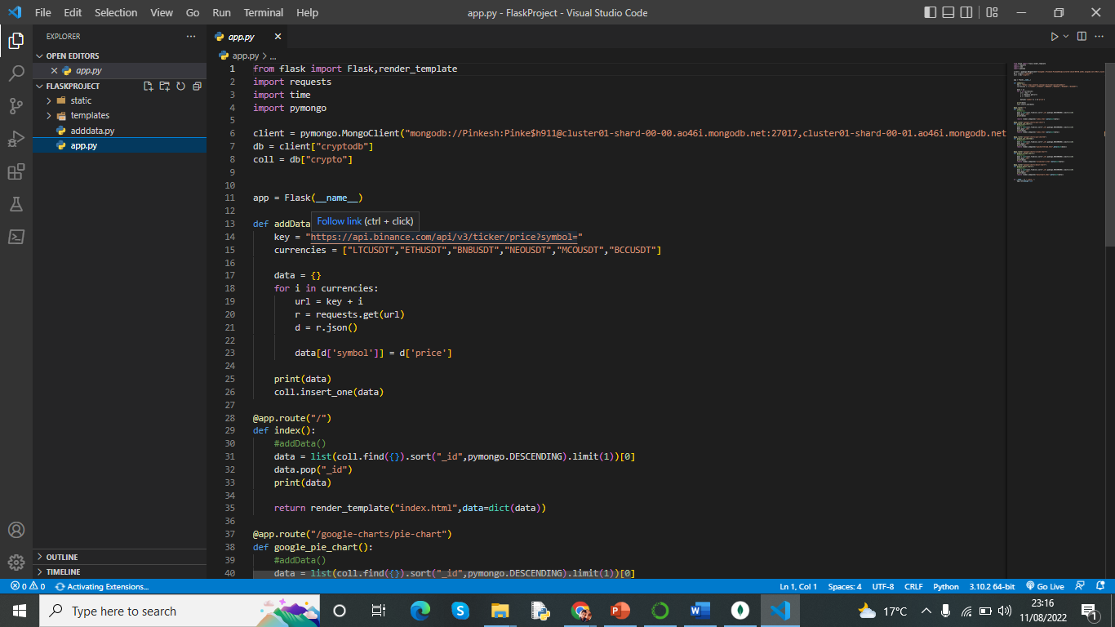
Here is a screenshot of our main app.py file. Which is a server side cod which written in python

Slide 14
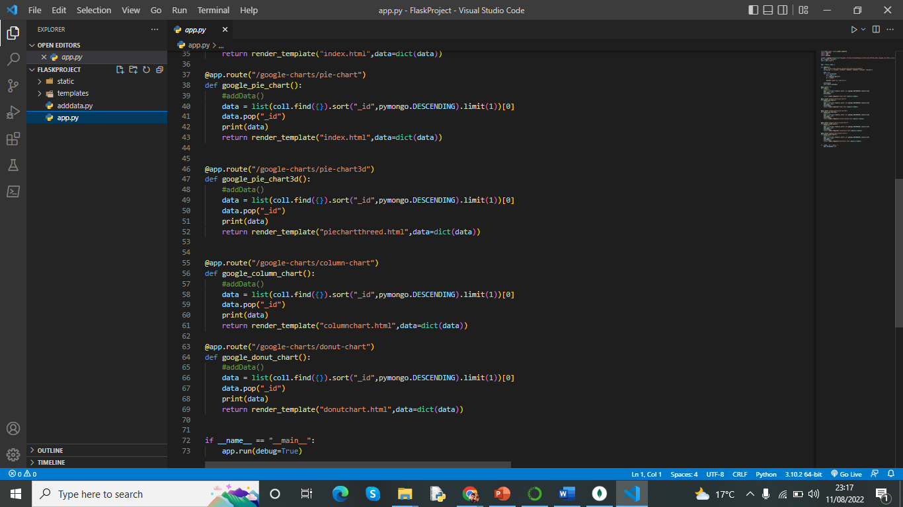
We have used a pie chart, donut chart, and column chart from google Charts.

Slide 15
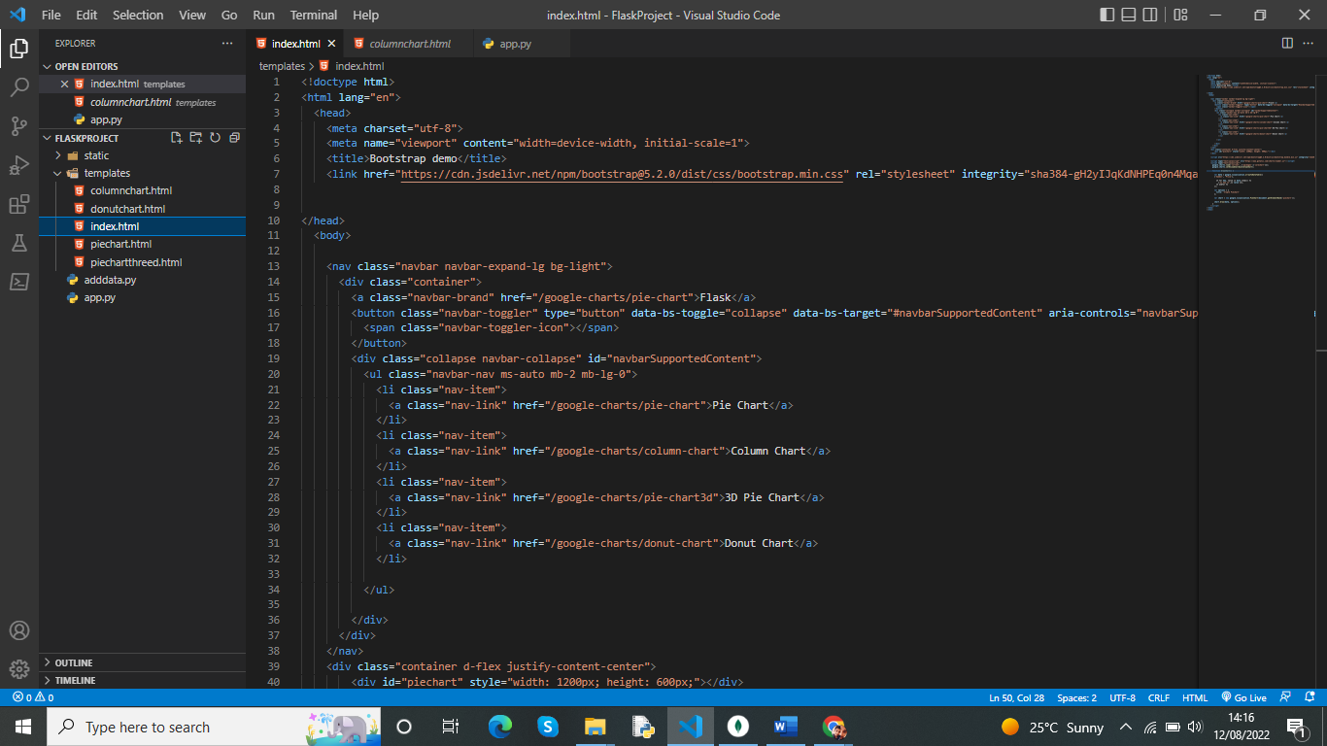
Here is the front-end code where we used bootstrap and google charts.

Slide 16
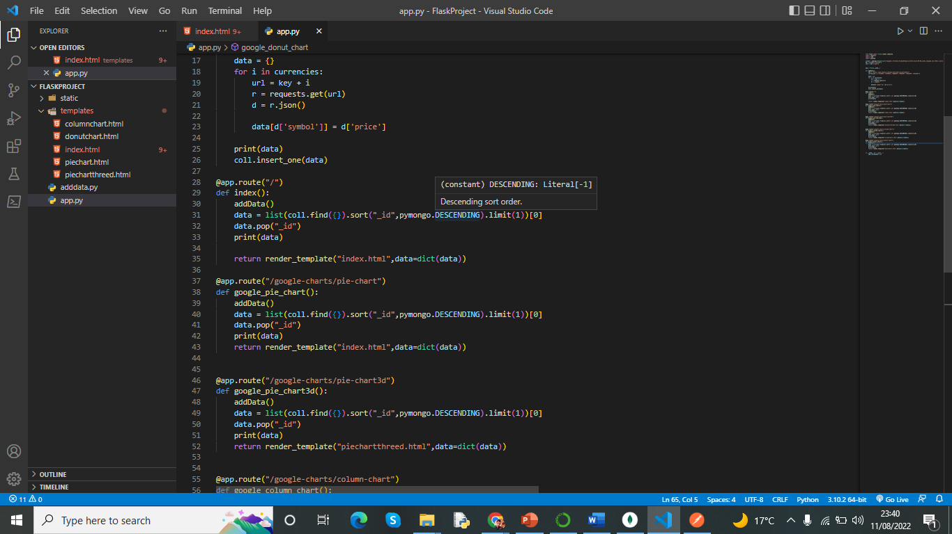
In addition, The addData() function we have marked which is used when we have to change data in when we change the chart type in web app and store that data into mongo DB. When we comment this line addData() it stop taking data in each click.

Slide 17
Process of deploying website.
We tried to deploy the website using the git bash terminal after creating a virtual environment, but we were not able to successfully deploy it.
So, we just created a Heroku account after creating an account.
We created a name for the application which was a flask project.
Then we uploaded all our programs on git hub and give access to that repository to the Heroku and then hosted on Heroku gunicorn server.

Slide 18
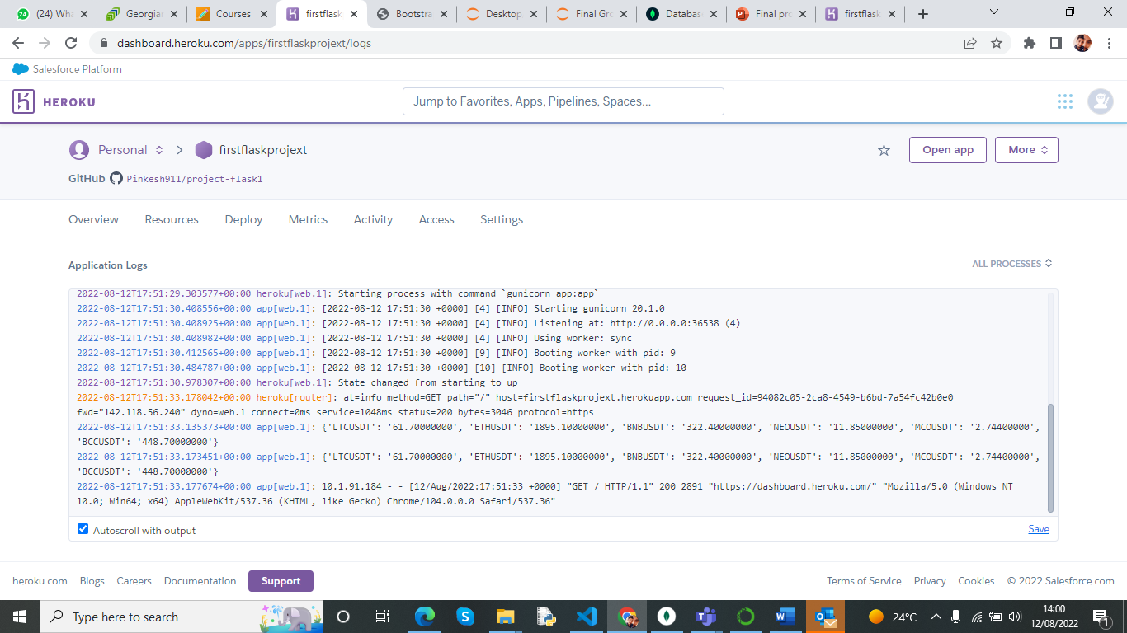
Screenshot of Heroku

Slide 19
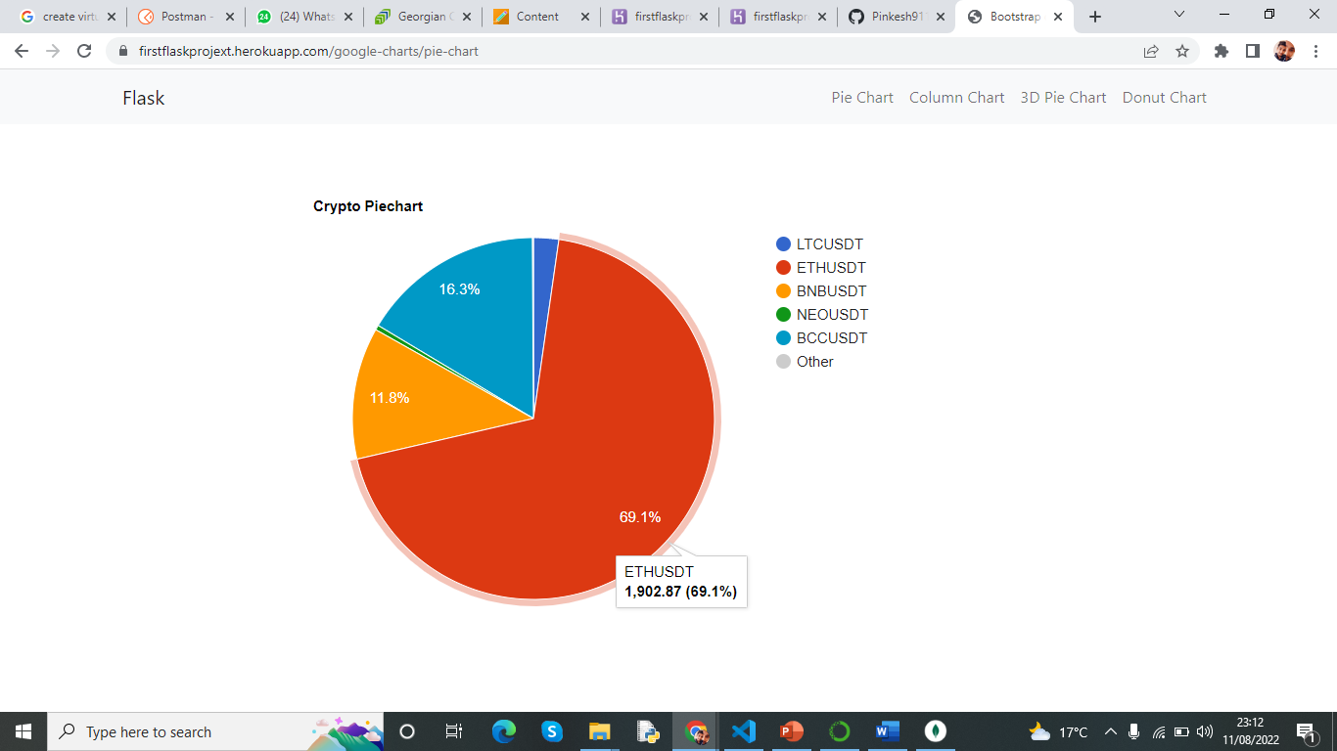
This is a normal 2D pi chart represent crypto price

Slide 20
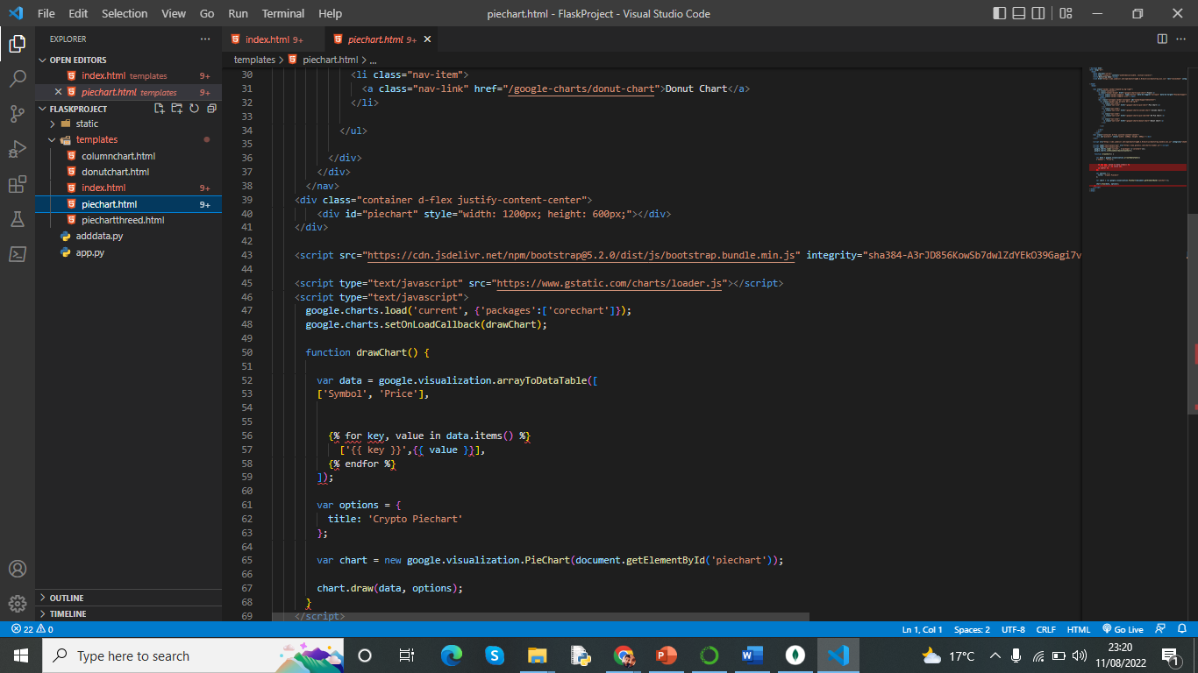
This is Pie chart code

Slide 21
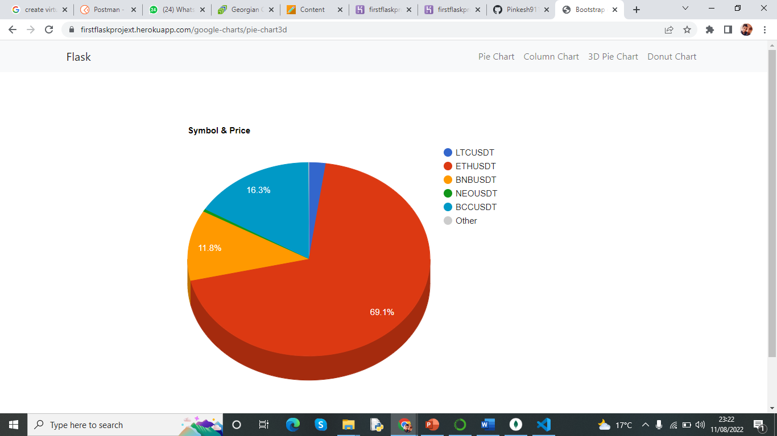
Crypto price is represented in 3D Pie Chart

Slide 22
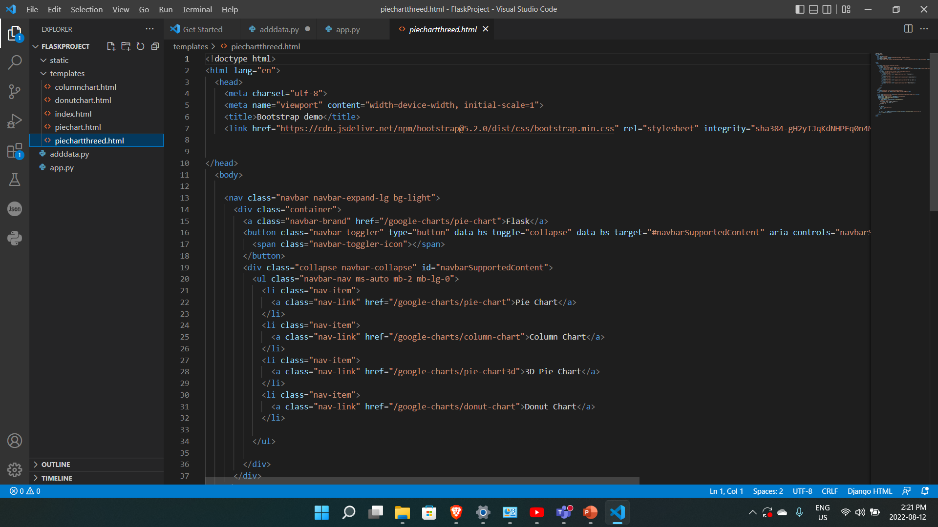
3D pi chart code

Slide 23
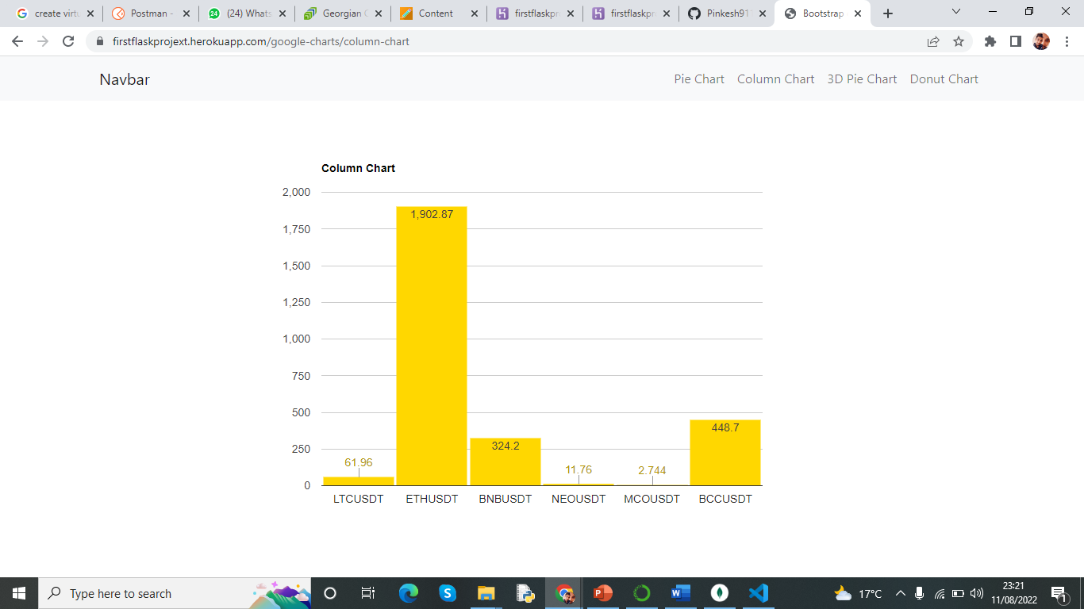
This is a Column chart of cryptocurrency

Slide 24
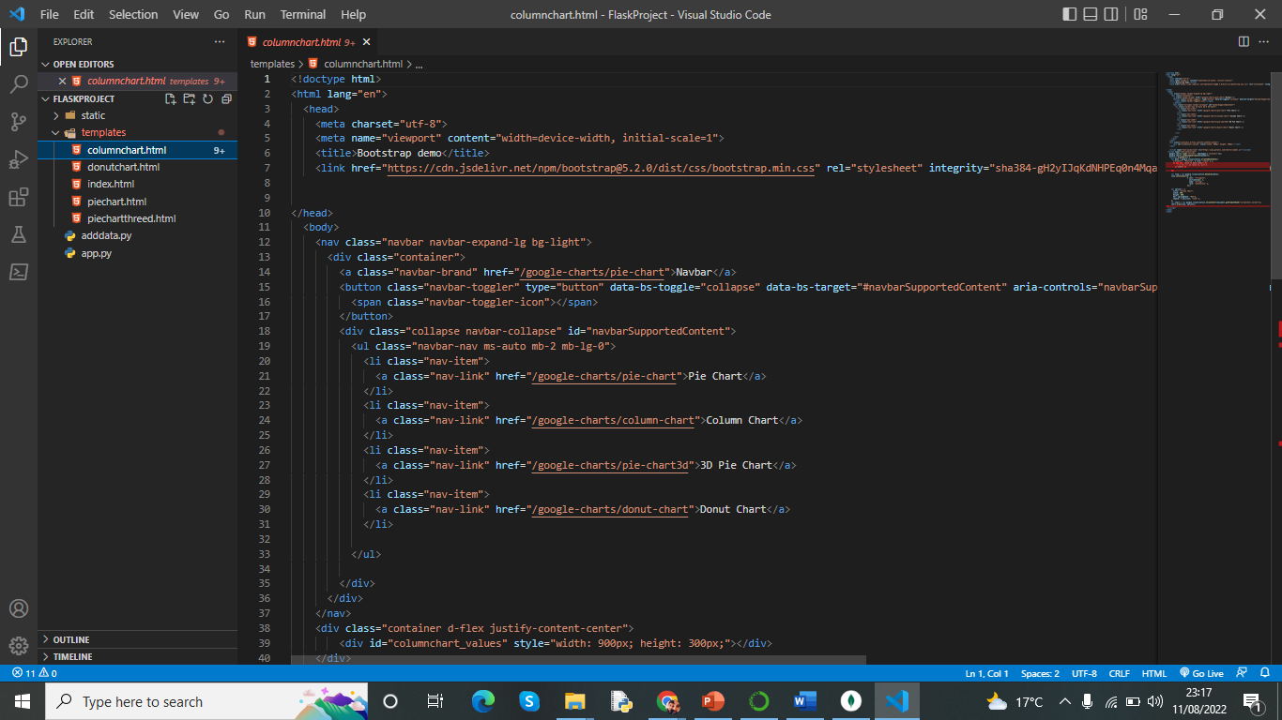
Code for column chart

Slide 25
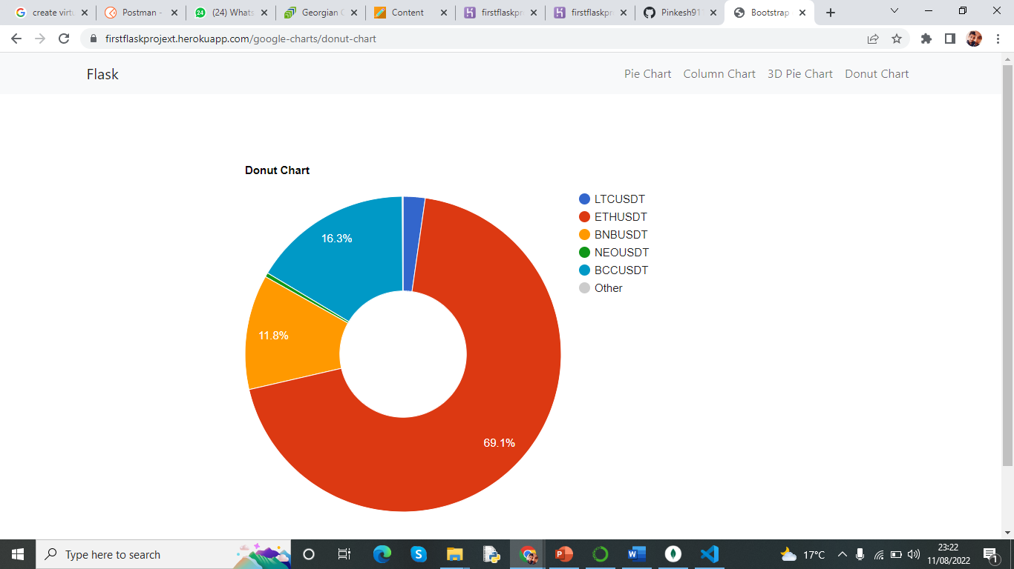
This is a Donut chart representation of few cryptocurrency

Slide 26
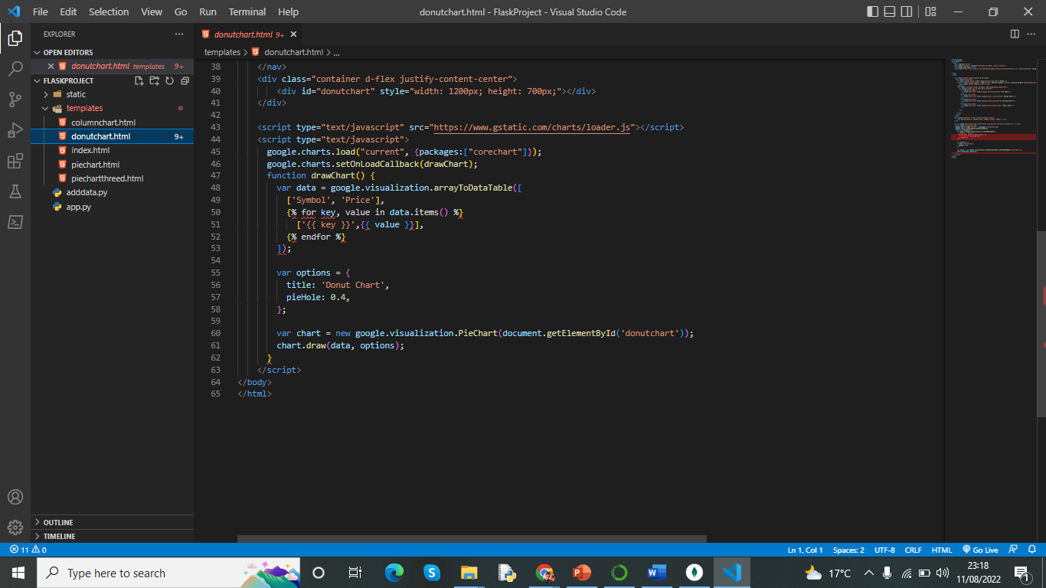
Quick look of donut chart code

Slide 27
Thank you
Now Project demo will be represented by Pinkesh

